Slide 1
CREDIT CARD DEFAULT PREDICTION
CAPSTONE PROJECT
Submitted By:-
RITHIK RANJAN MISHRA
MANIPAL INSTITUTE OF TECHNOLOGY(DEPTT. OF ICE)

Slide 2
OUTLINE
Problem Statement
Proposed System/Solution
System Development Approach (Technology Used)
Algorithm & Deployment
Result
Conclusion
Future Scope
References

Slide 3
PROBLEM STATEMENT
Credit card default prediction is a critical task in the financial industry, aiming to mitigate risks associated with lending and managing credit portfolios effectively. The problem revolves around predicting whether a credit card holder is likely to default on their payments in the future, based on various features such as demographic information, past credit behavior, and economic indicators.

Slide 4
SOLUTION
Collect historical credit card transaction data from reliable sources, including customer information such as demographics, payment history, credit limit, balance, etc.
Preprocess the data by handling missing values, outliers, and encoding categorical variables. Feature scaling may be necessary to ensure all features have the same scale.
Select appropriate machine learning algorithms for classification tasks, such as logistic regression, decision trees, random forests, gradient boosting, or neural networks.
Evaluate the models using performance metrics such as accuracy, precision, recall, F1-score, ROC-AUC, or Gini coefficient.

Slide 5
APPROACH
Understanding and Cleaning
● Find information on documented columns values
● Clean data to get it ready for Analysis
Graphical
● Examining the data with visualization
Machine Learning
● Logistic ● SVM ● Random Forest ● XGBoost

Slide 6
ALGORITHM & DEPLOYMENT
Data Collection and Preprocessing:
Collect historical data on credit card transactions and preprocess it by handling missing values, feature engineering, and normalization.
Model Selection and Training:
Choose a classification algorithm (e.g., Logistic Regression, Random Forest) and train it on the preprocessed data.
Evaluate the model's performance using appropriate metrics.
Model Serialization and Hosting:
Serialize the trained model into a deployable format (e.g., pickle) and set up a server or cloud instance to host it.
API Development and Security Implementation:
Develop an API or web service to expose the model's functionality for making predictions.
Implement security measures (e.g., encryption, authentication) to protect the deployed model and data.
Integration and Testing:
Integrate the deployed model with existing applications or systems used for credit card processing.
Thoroughly test the deployment for functionality, performance,

Slide 7
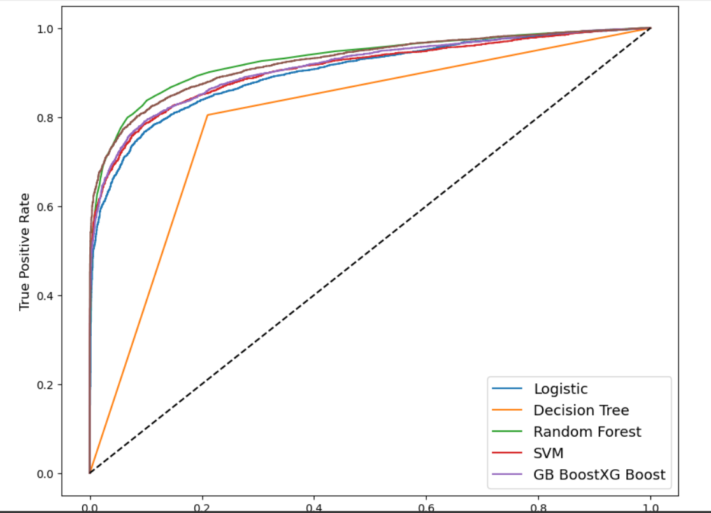
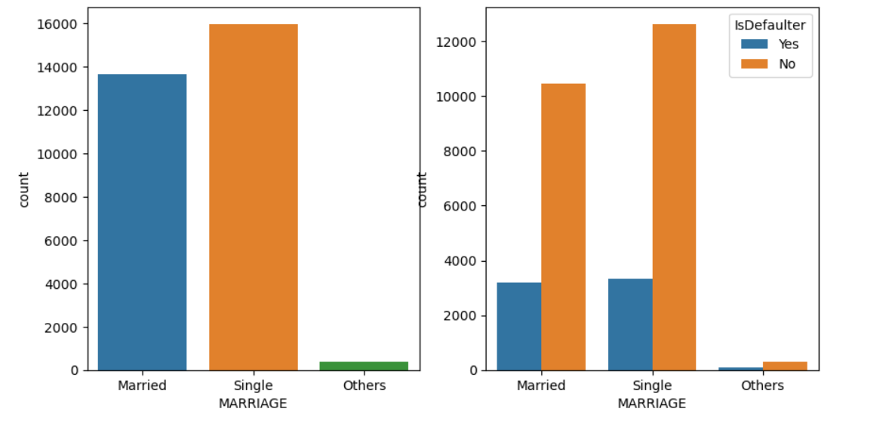
RESULT

Slide 8
CONCLUSION
From all baseline model, Random forest classifier shows highest test accuracy and F1 score and AUC.
Baseline model of Random forest and decision tree shows huge difference in train and test accuracy which shows overfitting
After cross validation and hyperparameter tunning, XG Boost shows highest test accuracy score of 87.10% and AUC is 0.874.
Cross validation and hyperparameter tunning certainly reduces chances of overfitting and also increases performance of model

Slide 9
REFERENCES
https://github.com/
Project Jupyter | Home

